Slide 1

P peline
The Data
Byte 4
© Jennifer Mankoff
The Data Pipeline; HCII; Spring 2014

Slide 2
Byte 4
Learning Goals:
Explore the value of mobile data
Address data quality issues
Work with location based data
Learn about how to set up a data store in Appspot
Learn about how to use AWARE

Slide 3
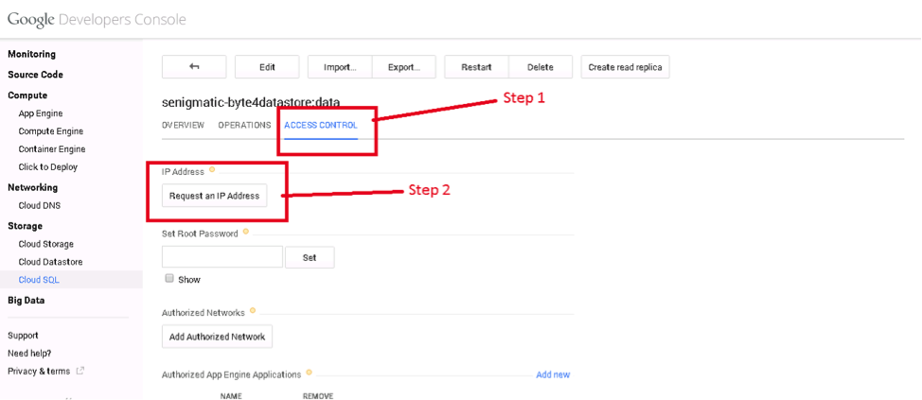
Setting up a Datastore
Google has great documentation (https://cloud.google.com/appengine/docs/python/cloud-sql/)
You need to customize the access permissions
Cloud Storage
Step 1: Request an IP address from Cloud (‘CloudIP’)

Slide 4
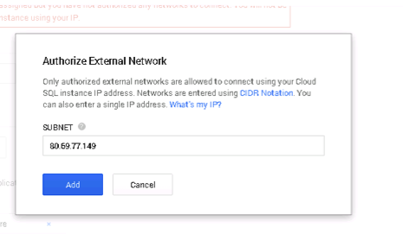

Setting up a Datastore
Google has great documentation (https://cloud.google.com/appengine/docs/python/cloud-sql/)
You need to customize the access permissions
Cloud Storage: ‘CloudIP’
Step 2: Give access permission to the ‘AWAREIP’
Aware Server AWAREIP = 80.69.77.149

Slide 5
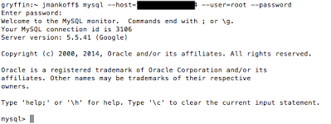
Setting up a Datastore
Google has great documentation (https://cloud.google.com/appengine/docs/python/cloud-sql/)
You need to customize the access permissions
Cloud Storage: ‘CloudIP’
Step 3: Test your connection to CloudIP

Slide 6
Setting up a Datastore
Google has great documentation (https://cloud.google.com/appengine/docs/python/cloud-sql/)
You need to customize the access permissions
Cloud Storage: ‘CloudIP’
CREATE USER 'newuser'@’AWAREIP' IDENTIFIED BY 'password'; GRANT ALL PRIVILEGES ON byte4.* TO 'newuser'@’AWAREIP';
Step 4: Use that connection to set up further permissions for AWARE

Slide 7
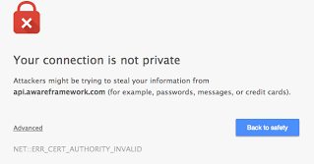
Set up the AWARE client
Cloud Storage: ‘CloudIP’
Step 5: Install the AWARE client on your phone

Slide 8
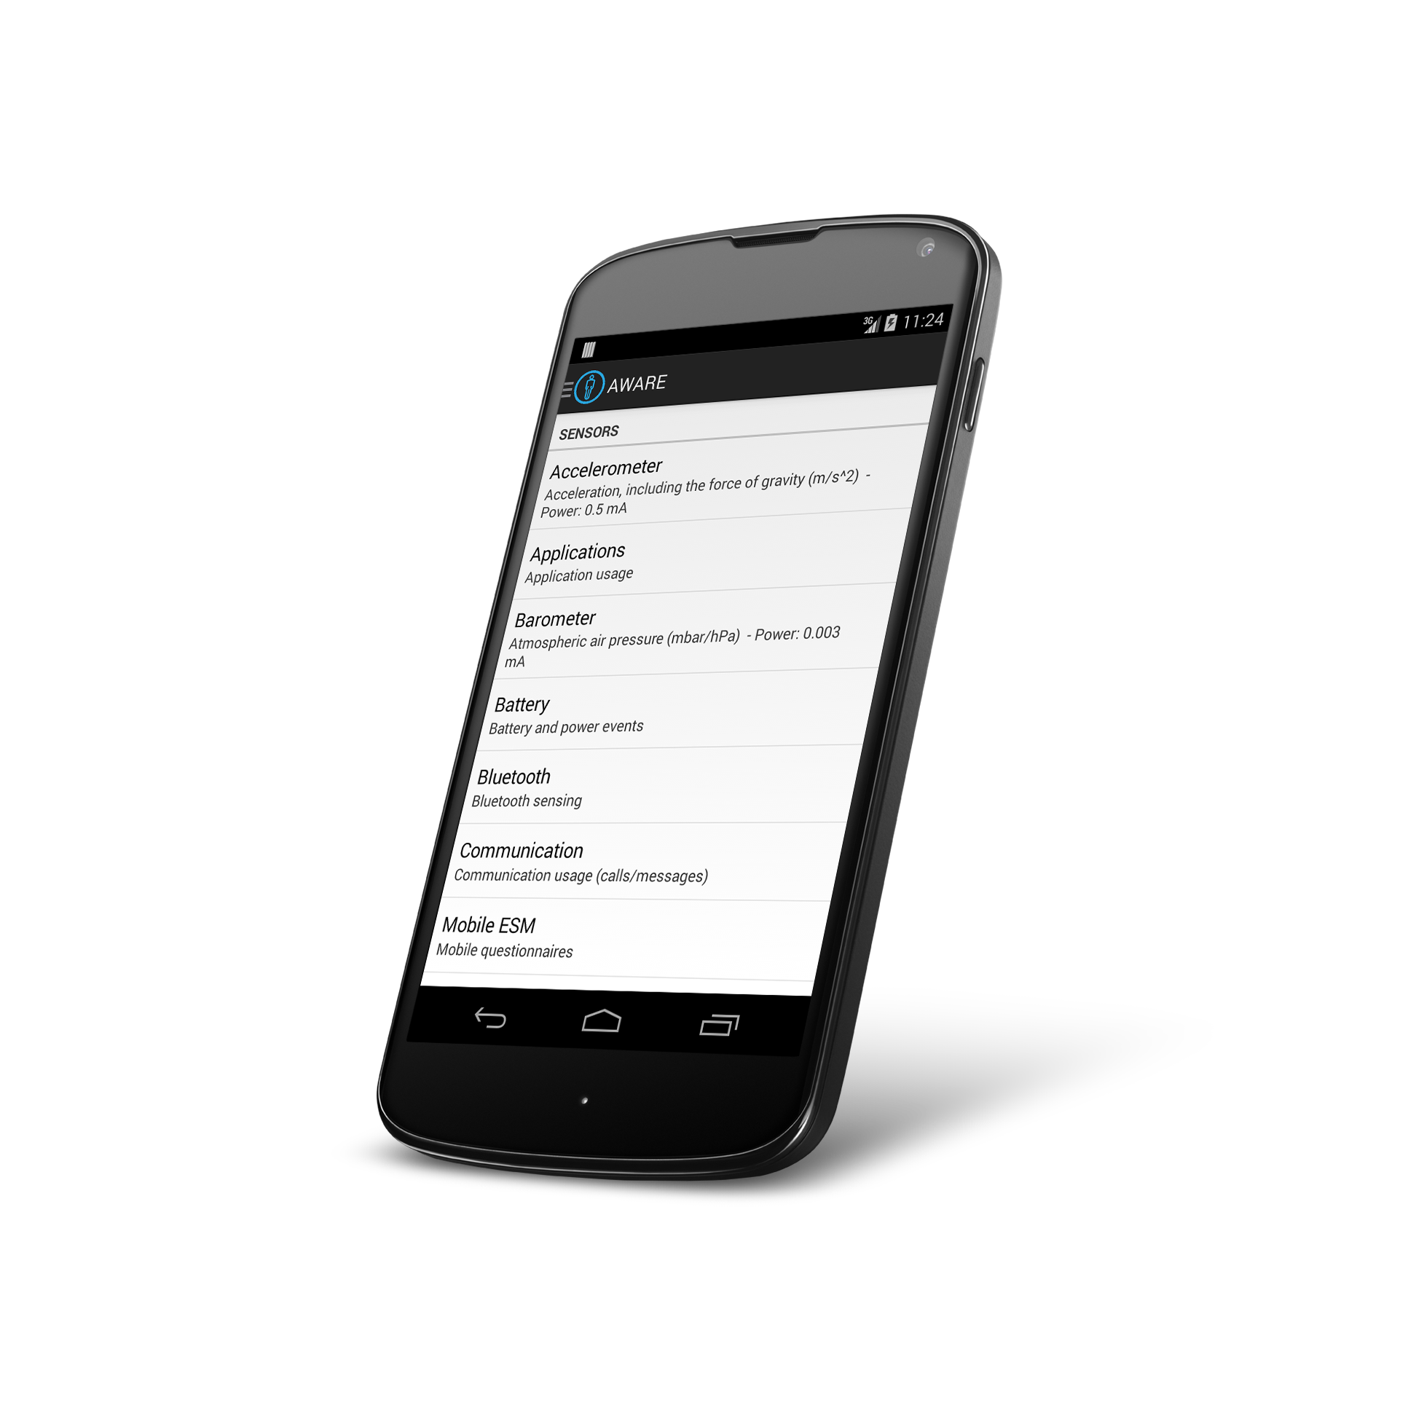
Set up the AWARE client
Visit http://www.awareframework.com on your phone
Download and install the latest AWARE client. If you have an Android Wear, it will also install on your watch
Cloud Storage: ‘CloudIP’
Step 6: Install the AWARE client on your phone

Slide 9
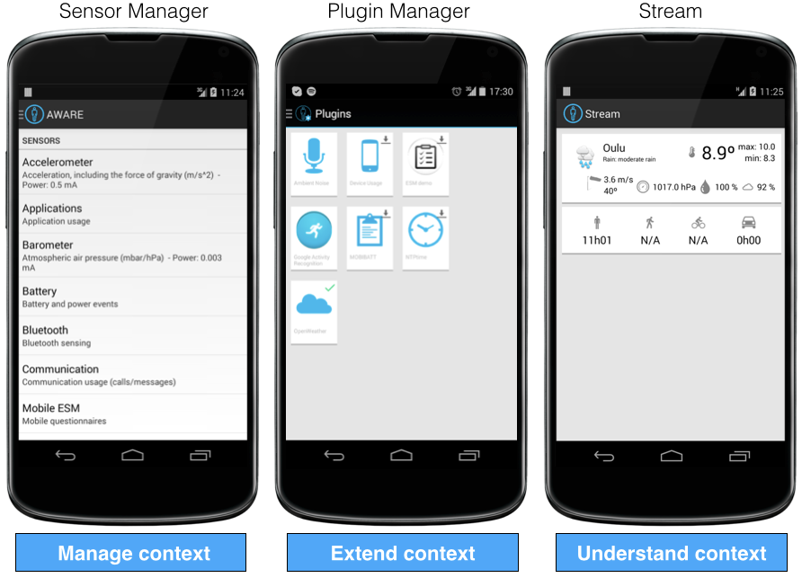
AWARE Client

Slide 10
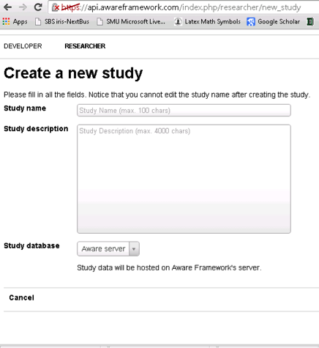
Set up the AWARE server
Cloud Storage: ‘CloudIP’
Step 7: Create a study

Slide 11
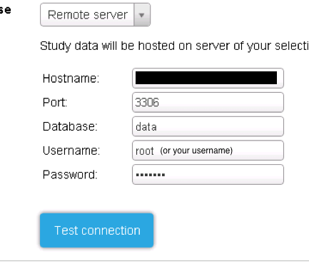
Set up the AWARE server
Cloud Storage: ‘CloudIP’
Step 8: Set the study database hostname to ‘CloudIP’

Slide 12
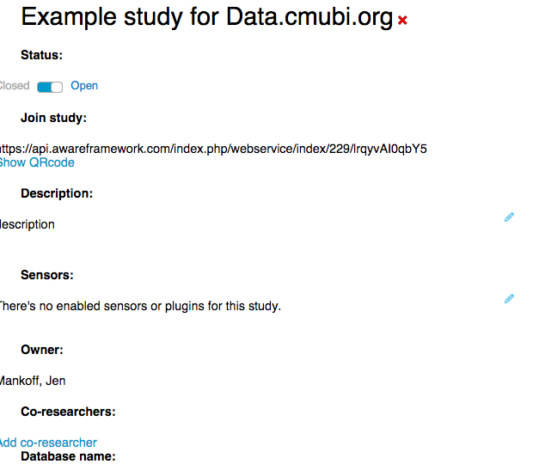
Set up the AWARE server
Cloud Storage: ‘CloudIP’
Step 9: Set up study sensors & so on

Slide 13
Set up the AWARE server
Cloud Storage: ‘CloudIP’
Edit study sensors by clicking on this
Step 9: Set up study sensors & so on

Slide 14
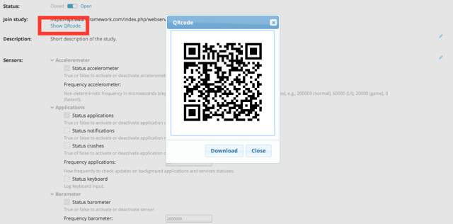
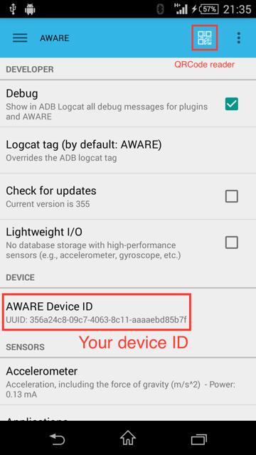
Connect the AWARE client with your study
Step 10: Join the study by launching the client, and choosing ‘Studies’ and then pointing the QR code reader at the QR code generated by the website when you click ‘Show QR Code’ for your study

Slide 15
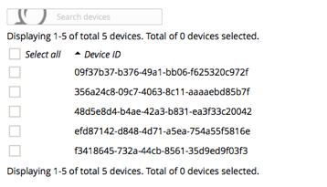
Double Check Everything
Step 11: Check that your phone is in the list of devices

Slide 16
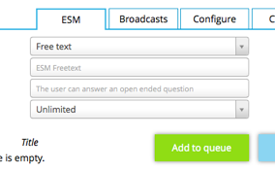
Double Check Everything
Cloud Storage: ‘CloudIP’
Step 12: Check that AWARE can communicate with your phone

Slide 17
Double Check Everything
Cloud Storage: ‘CloudIP’
Step 13: Check that AWARE is logging data to the cloud

Slide 18
Accessing MySQL
db = MySQLdb.connect(unix_socket='/cloudsql/' + _INSTANCE_NAME, db=_DB, user='root')
cursor = db.cursor()
Helper function – prints result to log
self.make_and_print_query(cursor, 'SHOW TABLES', 'Show the names of all tables')
Helper function – returns result as list
rows = self.make_query(cursor, query)

Slide 19
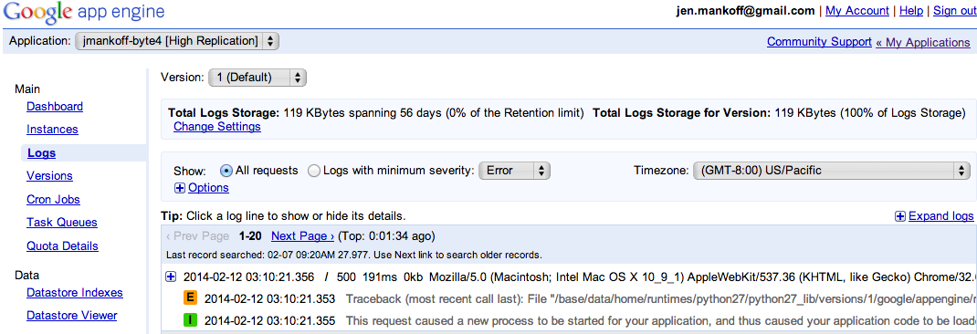
Debugging this assignment
Server side debugging is a bit of a pain
Google helps though – provides access to logs

Slide 20
More Debugging
My helper function prints recent SQL commands to log and catches SQL query errors
You may also see errors show up in the [yourname]-byte4 browser window

Slide 21
What do can need to do with mobile data?
Cleaning: can you tell when the phone is off? (not a focus of this byte)
Organizing: identifying common locations (what the byte walks you through)
Associating: connecting activities to other context (we explore location + activity, homework is to explore time + activity)

Slide 22
Basic Hand In Expectations
Improve the location binning by picking a better epsilon
Explore about relationship between time and activity (your main job on this assignment)
Display the results (more nicely than I do!)

Slide 23
Advanced Hand In Expectations
You could design a study that looks at something besides activity
Talk to me about goals & outcomes that make sense

